Slide 1
Stock Price Prediction
Submitted in the partial fulfillment for the award of the degree of
BACHELOR OF ENGINEERING
IN
BIG DATA
Submitted by:
Sushant Bisht
20BCS6148
Under the Supervision of:
Gurpreet Singh Panesar
Department of AIT-CSE
DISCOVER . LEARN . EMPOWER

Slide 2
Outline
Introduction to Project
Problem Formulation
Objectives of the work
Methodology used
Conclusion
Future Scope
References

Slide 3
Introduction to Project
Globalization .
More Data Created Daily.
Fluctuation in the stock market is violent.
Complicated Financial Indicators.
Advancement in technology helps in better prediction.

Slide 4
Problem Formulation
Most people don’t know the relationship between all financial assets.
It is difficult to predict what drives the price of each asset.
It is difficult to find a link between financial assets and the real economy.
The aim of the project is to examine a number of different forecasting techniques to predict future stock returns based on past returns to construct a portfolio of multiple stocks in order to diversify the risk. We do this by applying supervised learning methods for stock price forecasting by interpreting the seemingly chaotic market data.

Slide 5
Objectives of the Work
To examine a number of different forecasting techniques to predict future stock returns based on past returns.
To determine values that particular stock will have in the near future
To provide a platform where stock movements of the major companies are displayed.

Slide 6
Methodology used
Collect data from source
Normalize Data
Scale Data
Create a Training and Testing dataset
Train all the models using the training dataset
Test the model and determine the score
Predict the stocks using trained models
Compare the predictions of all models using a graph
Choose the best model between the algorithm
Save trained model
Display the model on the website
Show prediction of stock prices

Slide 7










BUSINESS IDEA
IDEA 1
Stock market prediction aims to determine the future movement of the stock value of a financial exchange.
IDEA 3
challenging issues
such as interest rates, politics, and economic growth
IDEA 2
IDEA 4
technical and fundamental analysis
forecasting the stock market with Machine Learning and Deep Learning

Slide 8

MARKET
WHAT?
WHO?
aims to determine the future movement of the stock value
Who will get benefit and at what level
WHERE?
WHEN?
The market is booming at present and will be beneficial to invest in.
price at which you want to buy or sell a share. Wait for the buyer or seller to reciprocate that request.

Slide 9
SOLUTION
Data
MACHINE LEARNING
Textual data preprocessing,
for sentiment analysis
We can get data from yahoo finance.
Random forest regressor
DEPLOYMENT
Future Work
Deploy the model on Heroku or some other platforms to get traffic
We need to regularly update the model as we have some external factors that create a challenging issue

Slide 10
BUSINESS MODEL
Random Forest Regression
Programming Lang
Ensemble learning
Train the model on some training dataset and then predict the outcomes for test data
Python, scikit-Learn, Pandas, Plotly, seaborn
Fetch Data
Deployment
We need to fetch huge data for data preprocessing. We can do it from various platforms like yahoo finance, Social Media, news articles, etc.
Deploy your model on some online platform like Heroku.

Slide 11
THE TEAM
MEMBER 1
MEMBER 3
Data Engineer
analytics engineer
MEMBER 2
MEMBER 4
Machine learning engineers
Data Scientist

Slide 12
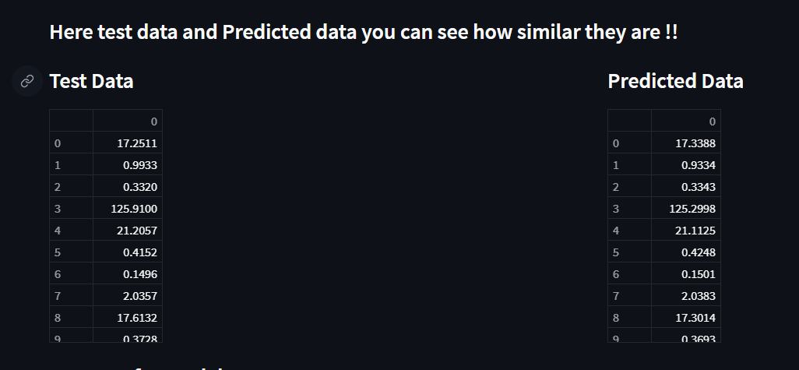
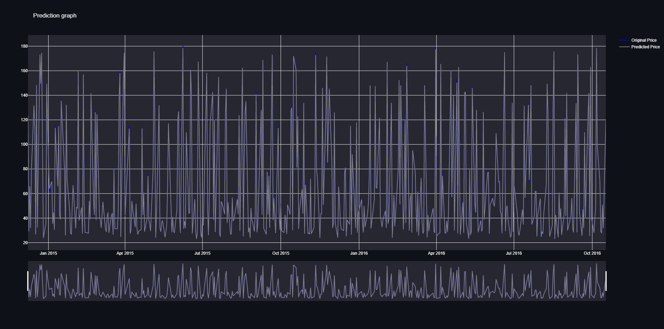
Results and Outputs

Slide 13
Conclusion
Here we can conclude that using the machine learning approach we can create a model which can forecast the stock price with higher accuracy.
We can modify the model using neural networks concept from Deep Learning.

Slide 14
References
Yahoo finance

